Slide 1
JupyterHub NAIRR Instructions
Workshop Lab Environments

Slide 2

JupyterHub
JupyterHub is a multi-user server designed to deliver Jupyter Notebooks to groups of users.
It manages authentication and spawns individual notebook servers for each person.
This provides a consistent computational environment without requiring users to install software locally.

Slide 3
Account Creation
For our current workshops, JupyterHub accounts use a universal password you can only receive during the workshop.
Using this password you can login to our JupyterHub with any username but there are limited slots.
The limit is 1 account per person.
Future workshops will use your ACCESS login or Github/Gitlab account but for the moment, in the next couple of workshops, the universal password will be used.
The password will be given after these slides.

Slide 4
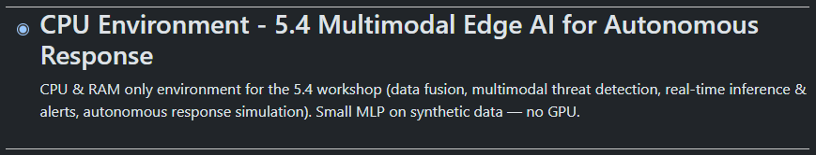
Lab Environments
When you login into JupyterHub you'll will see either one or many virtual environments.
The example on the side shows exactly one environment that is designed specifically for the 5.4 Workshop. Each environment for these workshops are built with all the packages and specific version python.

Slide 5
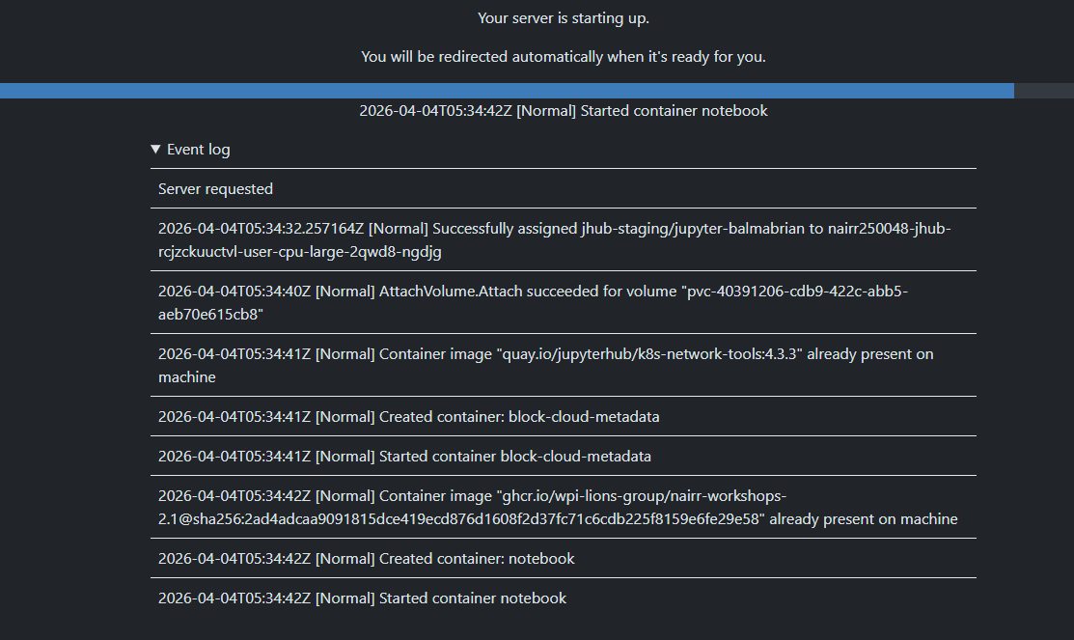
Starting a Server
Starting a server will communicate with our Jetstream2 services to deploy a container to host a notebook environment.
On the side is the process and event log of this server creation.

Slide 6
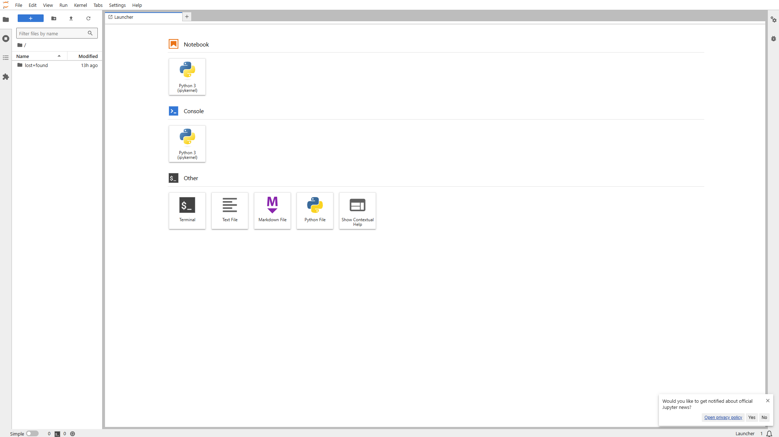
Starting a Sever

Slide 7
Accessing our lab materials
All enviorments have the nbgitpuller software installed which allows our us to easily clone any repository into our servers using a simple link.
Links will be provided after these slides but an example of what process look like is on the side.

Slide 8
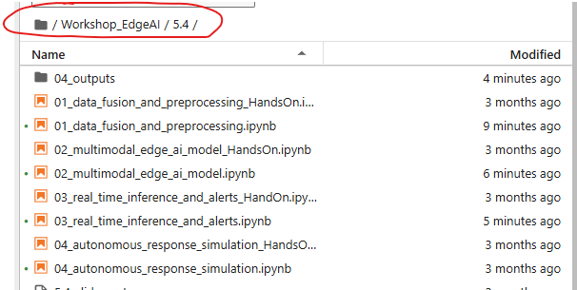
For 5.4
Once you have a server up, please click this link here. You should be redirected then to the server again but now have all the files and notebooks needed for today's workshop.
Once loaded, you'll be dropped straight into the 5.4 workshop folder
Click me to pull in our code!

Slide 9
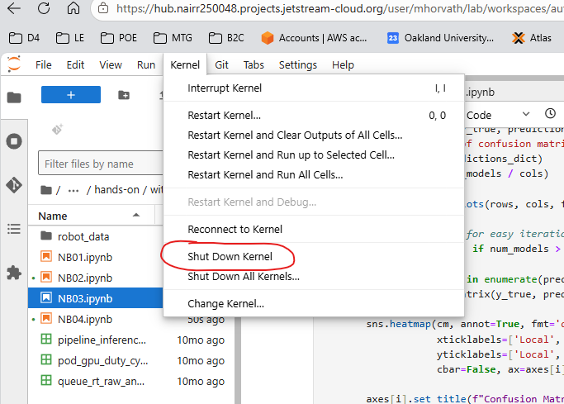
For 5.4 (Good advice overall though)
- Run one notebook at a time. When you are totally done with a notebook, shut down its kernel before opening the next.

Slide 10
Live Demo

Slide 11
Links, Passwords, & Git Repository

